Slide 1
Diabetes Disease Prediction Using Machine Learning
By
Sourav Salunkhe

Slide 2
INTRODUCTION
What is Machine Learning ?
Goal of the Project
What is Supervised Learning ?

Slide 3
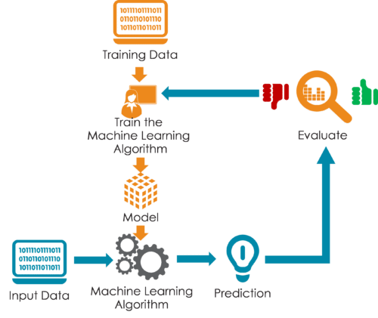

Slide 4
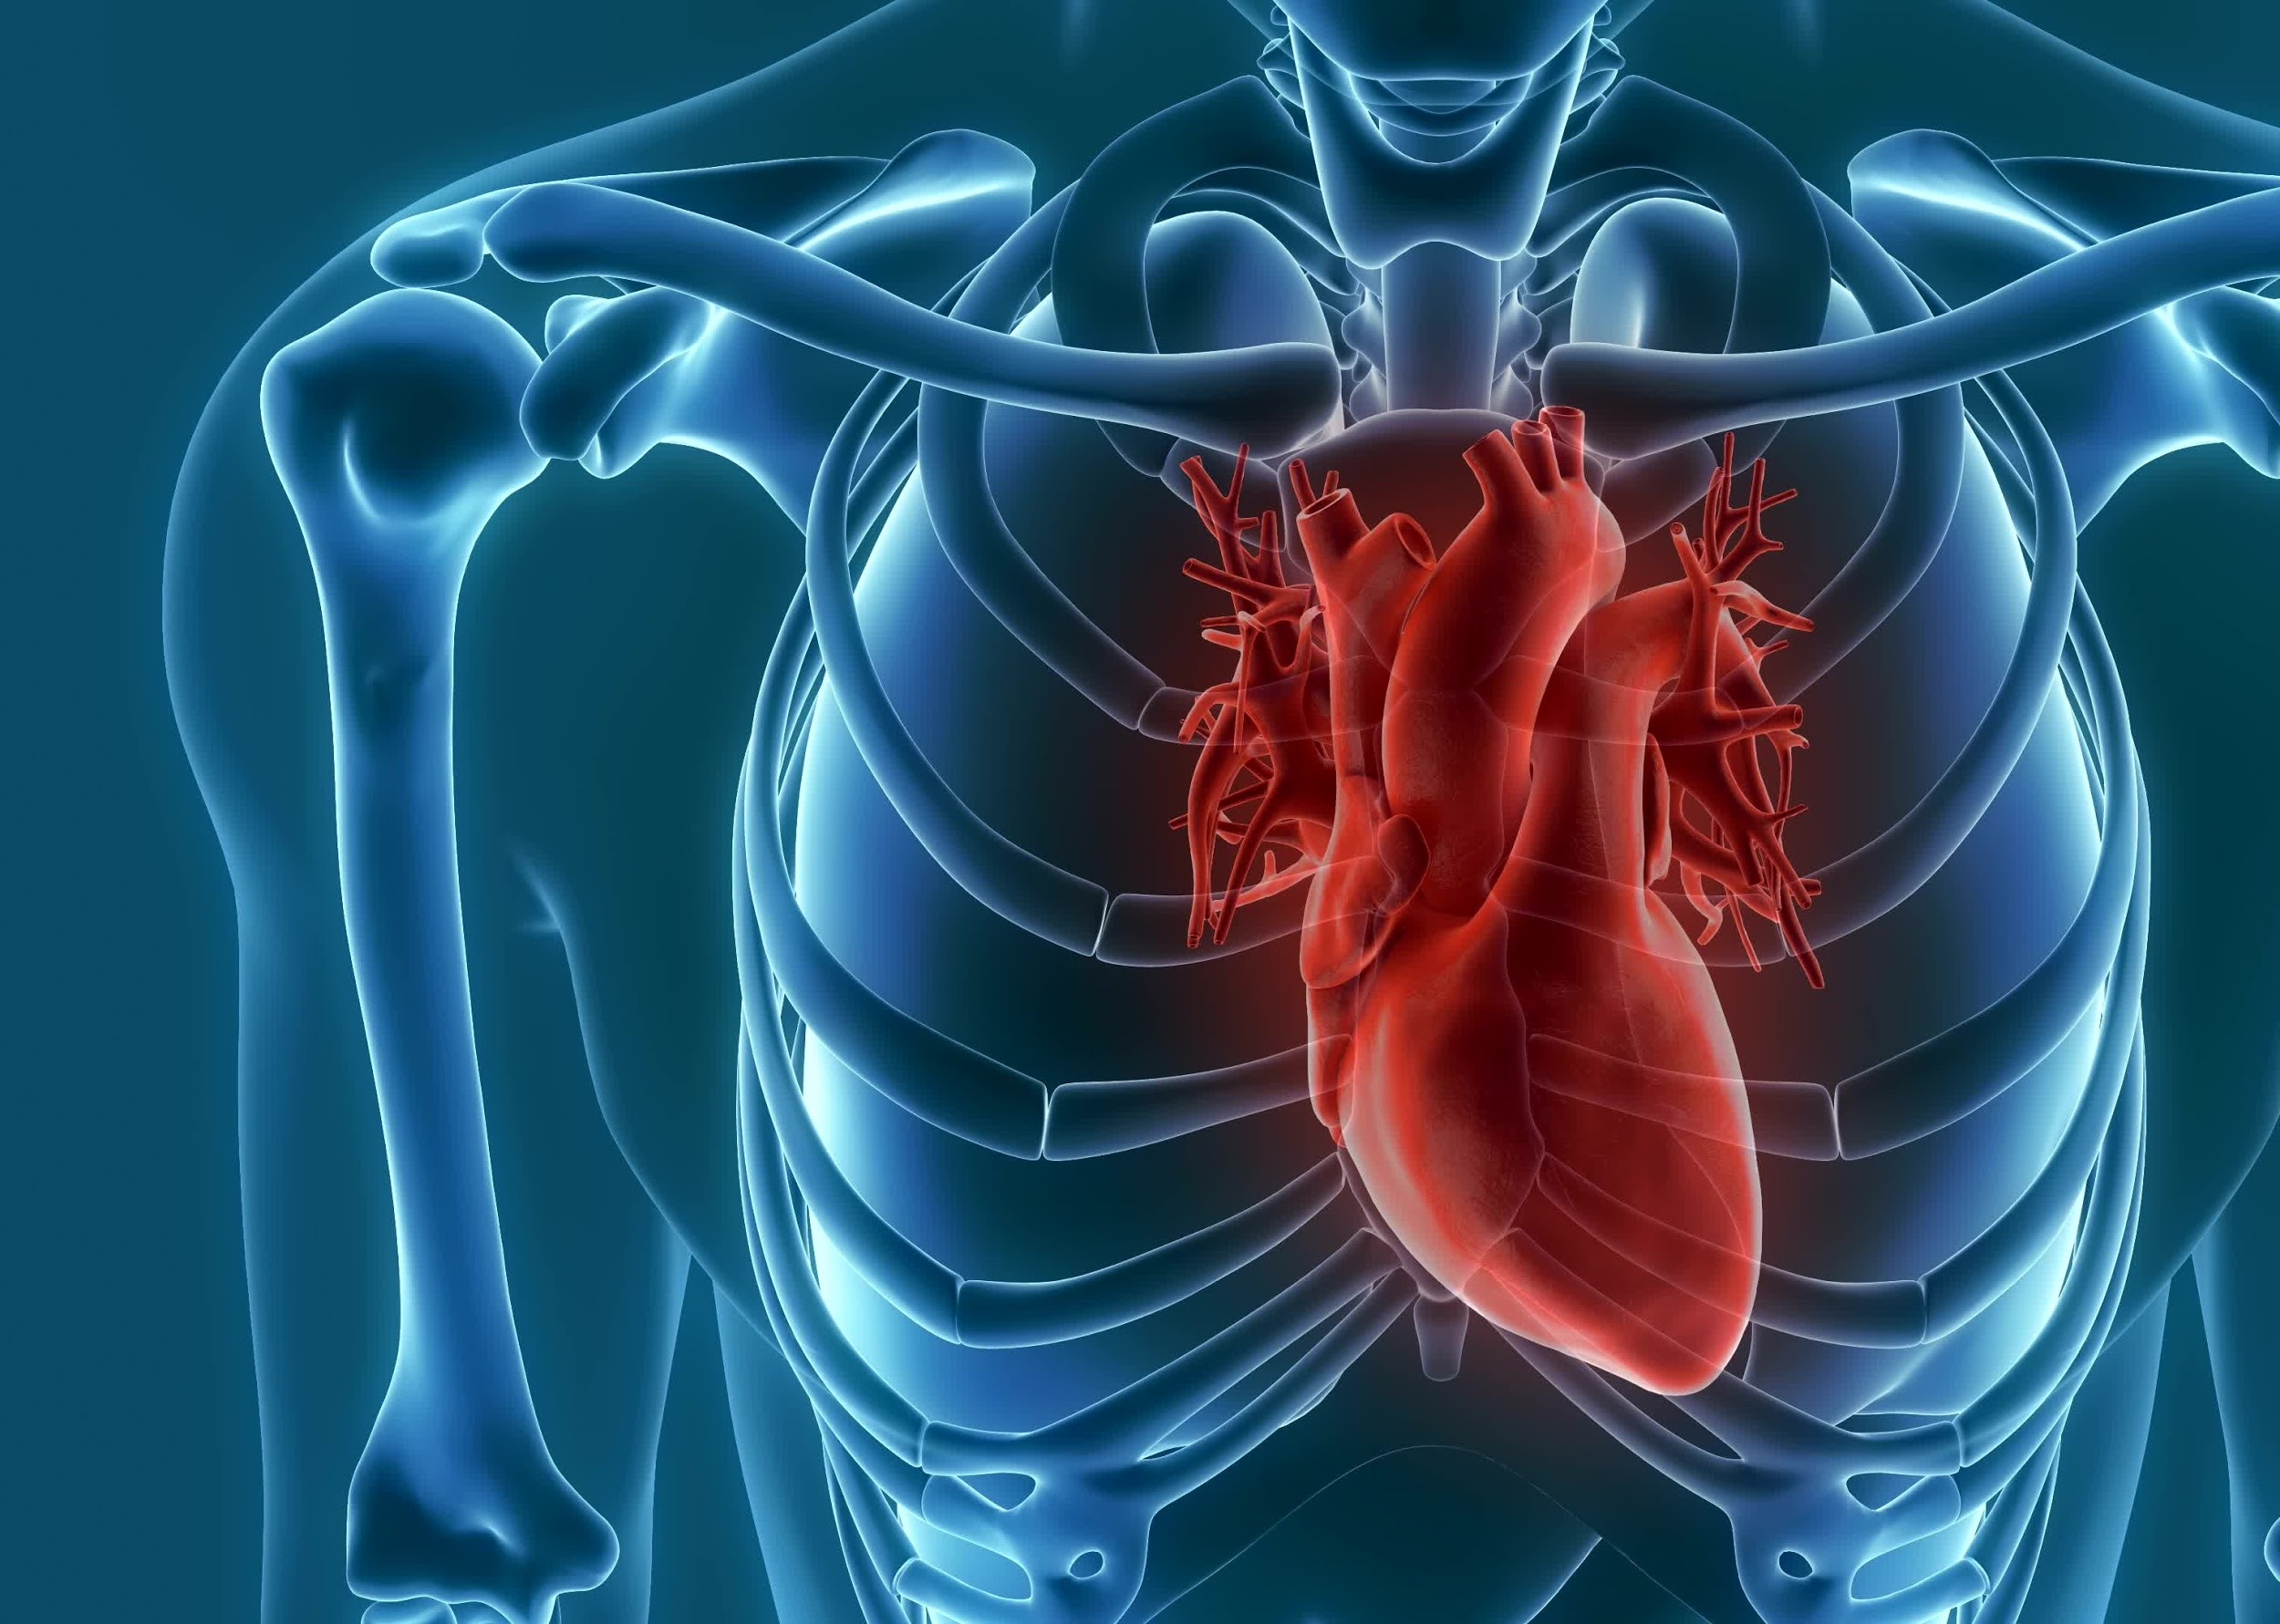
The Working of the Project

Slide 5

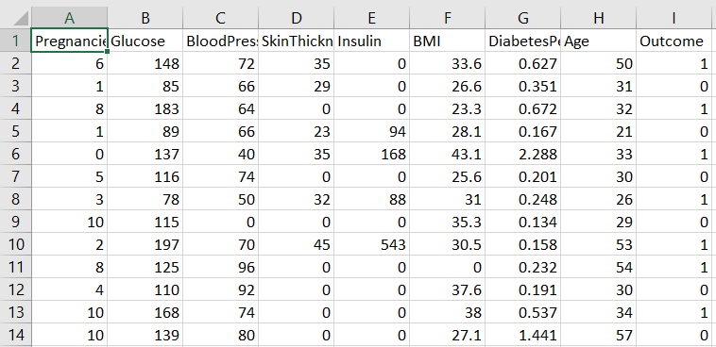
Dataset

Slide 6
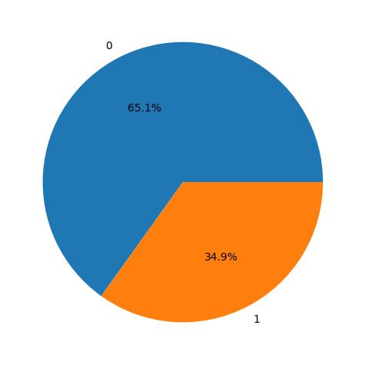
1 268
0 500

Slide 7
3 step process
Split the dataset
Train the dataset
Compare the Algos

Slide 8






Slide 9
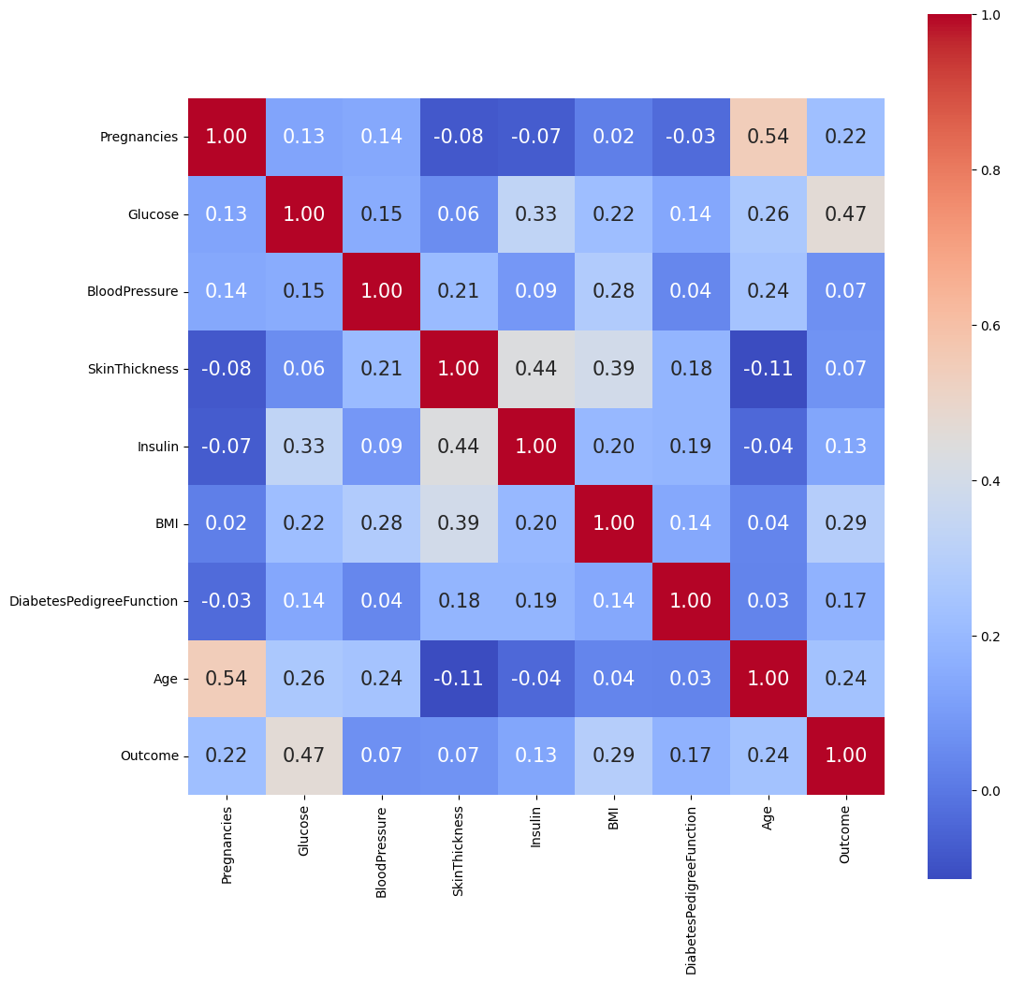
Correlation
Plot

Slide 10
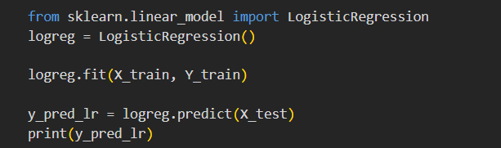
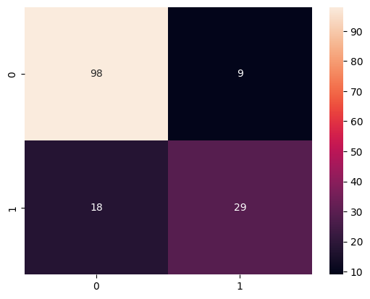
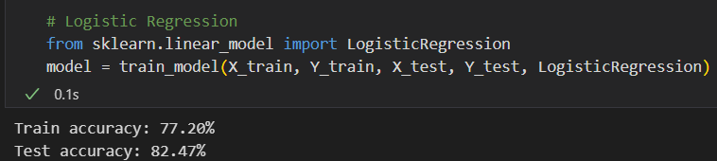
Logistic Regression
Precision: 0.76
Recall is: 0.61
F-Score: 0.38
accuracy score : 82.47 %

Slide 11
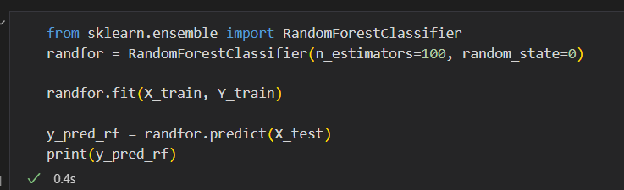
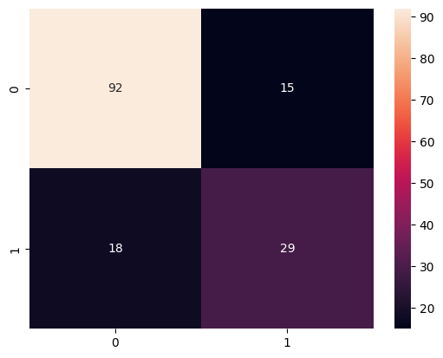
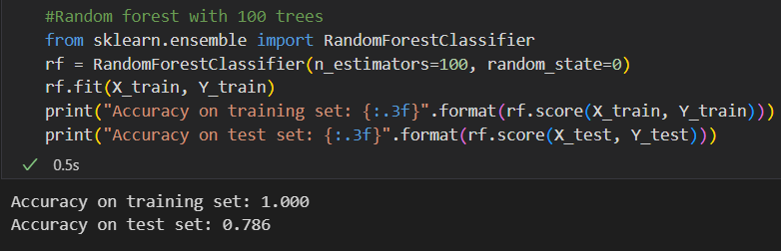
Random Forest
Precision: 0.65
Recall is: 0.61
F-Score: 0.63

Slide 12
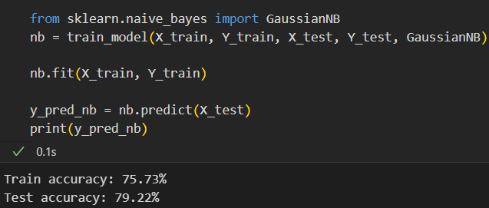

Naive Bayes
Precision: 0.67
Recall is: 0.61
F-Score: 0.64

Slide 13
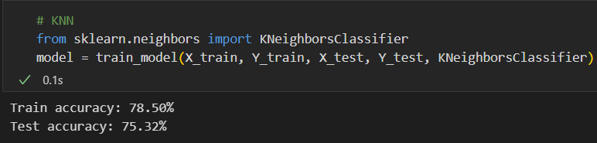
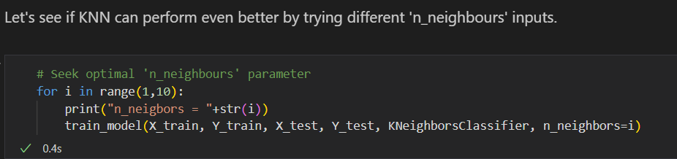
K-Nearest Neighbor

Slide 14
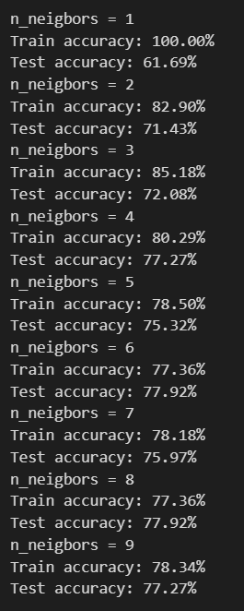

Precision: 0.66
Recall is: 0.55
F-Score: 0.60

Slide 15
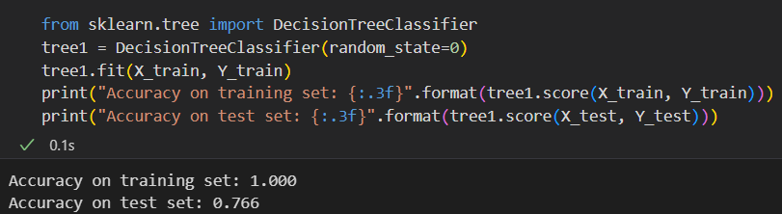
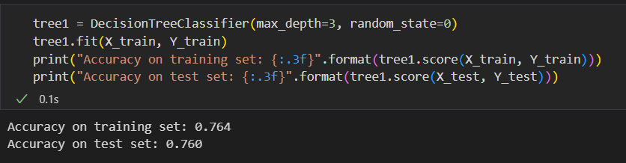
Decision Tree

Slide 16
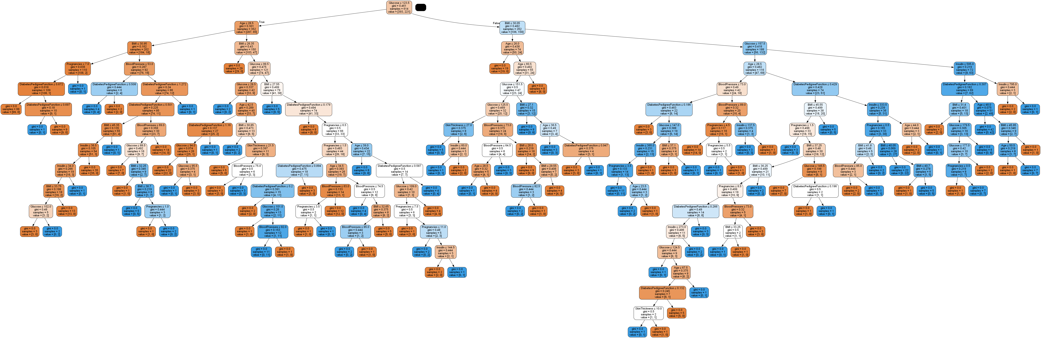

Slide 17
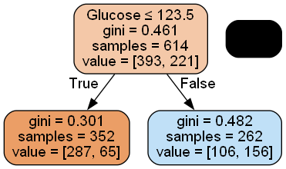

Slide 18

Precision: 0.63
Recall is: 0.51
F-Score: 0.46

Slide 19
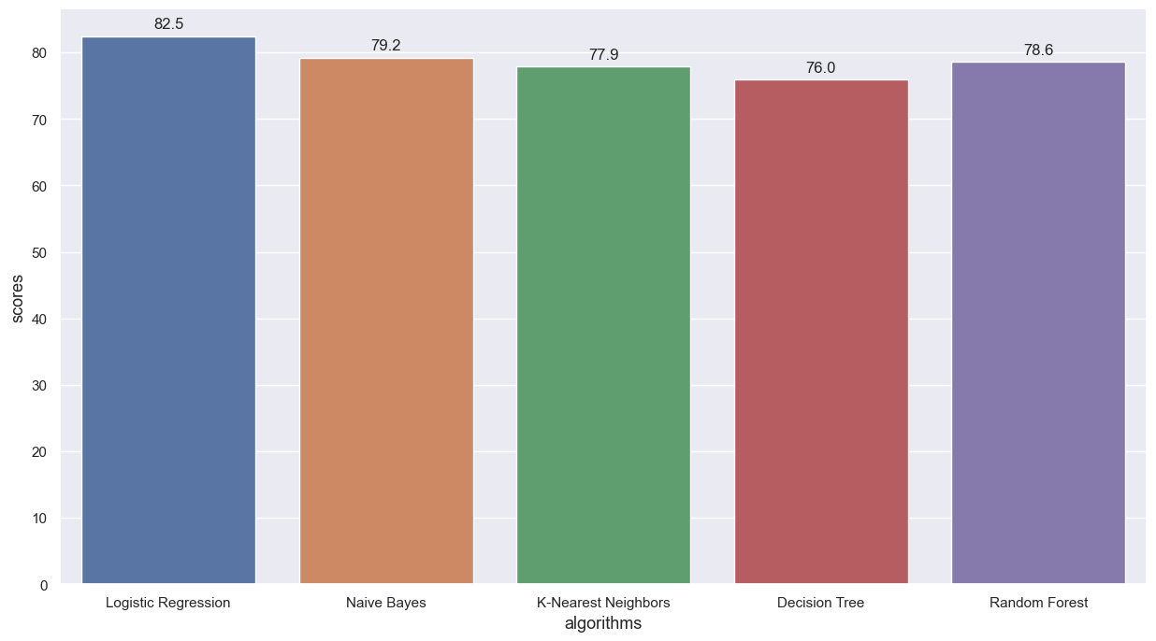
Results

Slide 20
Conclusion
Drawbacks
Future Scopes

Slide 21


